Slide 1
DigitizerPileupActor
Combines digis in the same volume if they occur within a short time interval (property time_window)
Attribute TotalEnergyDeposit of the resulting digi is the sum of energies
Property time_window_policy determines whether the time window can be extended or not
Other properties
  group_volume
  position_attribute_policy
  attribute_policy
Currently only in single-threaded simulations

Slide 2
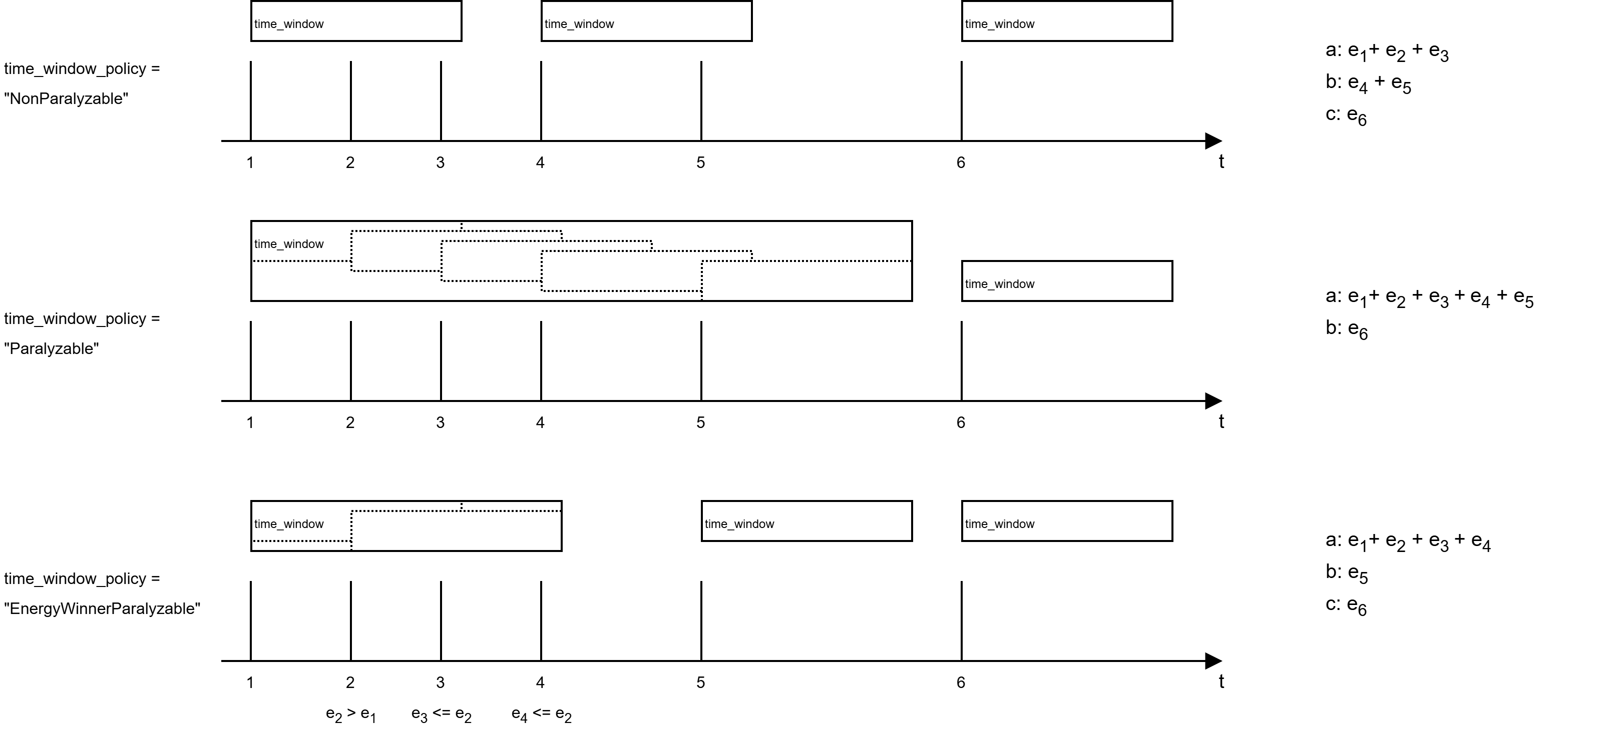
DigitizerPileupActor
1, 2, 3, ... : input digis
a, b, c : output digis
e₁, e₂, e₃ : energy of input digis

Slide 3

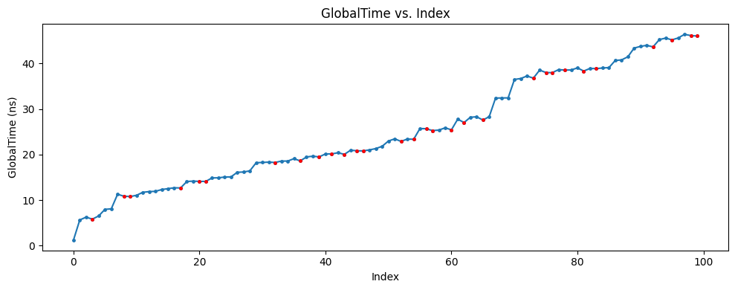
DigitizerPileupActor
Digis must be time-sorted
3
2
primary event
D
digi
1
4
3 is processed after 2
but happens earlier
1
3
2
4
time

Slide 4
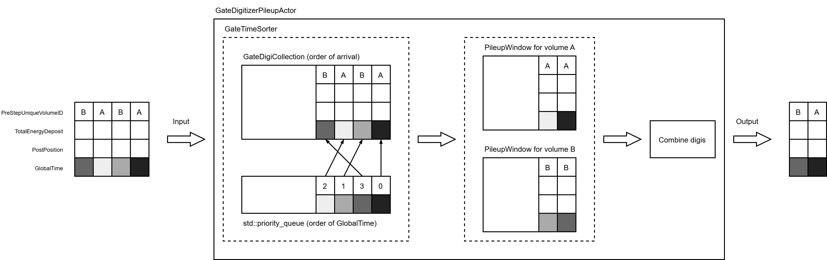
DigitizerPileupActor
Implementation
Time-sorting
Grouping per volume
Can be re-used in other actors that require time-sorting, e.g. coincidence sorter

Slide 5
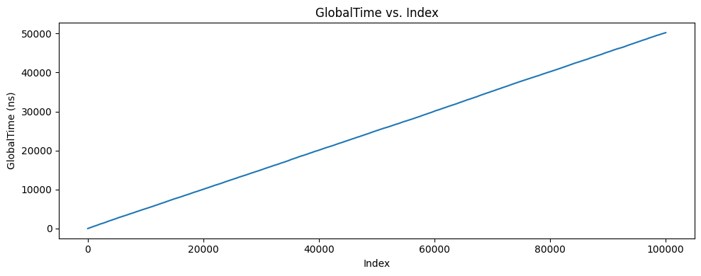
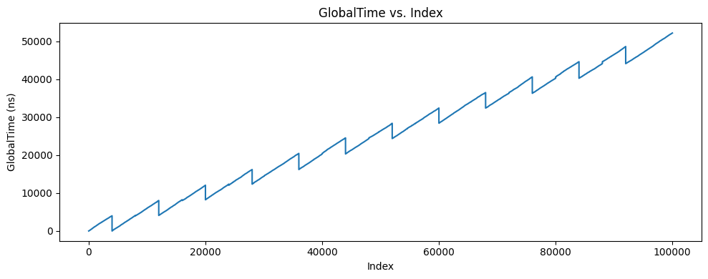
Coincidence sorter
number_of_threads = 1
coincidences_sorter.py
  Used for off-line coincidence sorting
  Input = singles root file from finished simulation
  Challenge: dealing with root files from multi-threaded simulations
  Status
    Mostly finished
    Limitations
      No support yet for delayed time window
      Does not work with root files from a simulation that specifies source.n instead of source.activity
CoincidenceSorterActor
  Used during the simulation itself
  No need to save singles to root file
  Status
    Working implementation (tested for equivalence with off-line implementation)
    Delayed window possible
    To do:
      documentation
      multi-threading
number_of_threads = 2

