Slide 1

Agenda – 1 hour
Status of PET simulations in GATE10

Slide 2
Status of PET simulations
Reminder: PET simulation steps
Digitizers (online)
Hits processing (offline)
Work in progress

Slide 3
PET simulation
Geometry
Sources
Physics
Acquisition timing
Scorers (actors)

Slide 4
PET simulation
Geometry
  Volumes and repeaters ; complex hierarchy
  Repeated translations and rotations
  Contrib: siemensbiograph.py and philipsvereos.py
  Test049 : pet = pet_biograph.add_pet(sim, "pet")
  Status: working
Sources
Physics
Acquisition timing
Scorers (actors)

Slide 5
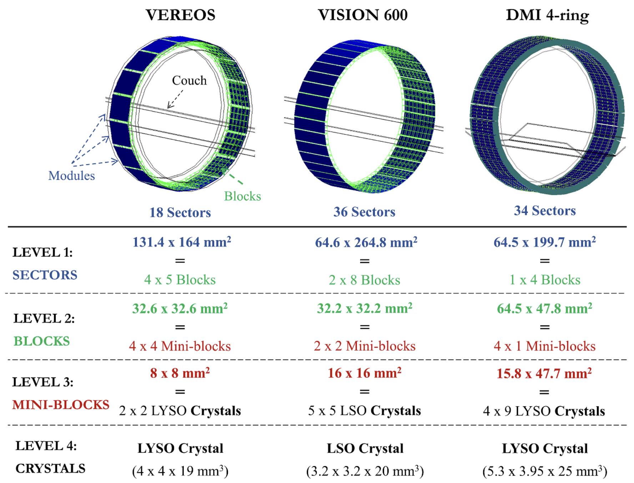

Slide 6
PET simulation
source.particle = "ion 9 18"
Phase space: check with ions ?
from opengate.sources.utility import get_rad_yield
yield = get_rad_yield(“F18”)
source.particle = "e+"
source.energy.type = ”F18”
source.activity = 10 * MBq * yield
Geometry
Sources
  Ion source: like in G4. Working. Slow.
  Positron source: beta+ spectra available. Working
  Gamma source: back_to_back. Working
  Voxelized source : Working
  Test031: like in Gate9
  Test072: back_to_back
Physics
Acquisition timing
Scorers (actors)
CHECK ICRP107 ?
(matthew)
Cu64 ?
data = get_spectrum(rad, "e+", "radar")
x = data[:, 0] # energy E(keV)
y = data[:, 1] # proba dNtot/dE b+
source.particle = "back_to_back"

Slide 7
PET simulation
Geometry
Sources
Physics
  As usual. Physict list, cuts, etc. In any volumes.
  PL: ShieldingLEND ? QGSP_BIC_AllHP, add a test.
  (Cerenkhov ? See with optical simulation): check in doc.
  Working
Acquisition timing
Scorers (actors)
"Please setenv G4PARTICLEHPDATA (recommended) or, at least setenv G4PROTONHPDATA to point to the proton cross-section files."

Slide 8
PET simulation
Geometry
Sources
Physics
Acquisition timing
  Use “activity” in Bq as source
  sim.run_timing_intervals = [[3600 *sec, 7200 * sec]]
  print(f”Total time is {time/sec} seconds”)
  Working (also with MT !)
Scorers (actors)

Slide 9
Digitizer chain
New implementationn, more flexible (no more pre-defined hierarchy)
List of actors (digitizer modules):
  DigitizerHitsCollectionActor : always start by this one (ONLINE)
  DigitizerReadoutActor or DigitizerAdderActor : from hits to singles (ONLINE)
  DigitizerBlurringActor : blur E or time
  DigitizerSpatialBlurringActor : position blurring
  DigitizerEfficiencyActor : drop some events
  DigitizerEnergyWindowsActor : (SPECT) split in ene windows
  DigitizerProjectionActor : (SPECT) projection image
Output : a root file
  Each actor can add a “tree” to a root file (same or different)
  The “branches” of all trees are defined in the attributes
Working (also with MT !)

Slide 10
hc = sim.add_actor("DigitizerHitsCollectionActor", “hits”)
hc.attached_to = crystal.name
hc.authorize_repeated_volumes = True
hc.output_filename = “my_output.root”
hc.attributes = [
"PostPosition",
"TotalEnergyDeposit",
"PreStepUniqueVolumeID",
"GlobalTime",
]
sc = sim.add_actor("DigitizerReadoutActor", “singles”)
sc.authorize_repeated_volumes = True
sc.attached_to = crystal.name
sc.input_digi_collection = hc.name
sc.group_volume = crystal.name
sc.discretize_volume = crystal.name
sc.policy = "EnergyWeightedCentroidPosition"
sc.output_filename = “my_output.root”

Slide 11
Special attributes
To counts Compton (or other processes) per hits
Just add “parametrized” attributes to the HitsCollection
att1 = ProcessDefinedStepInVolumeAttribute(sim, "compt", waterbox1.name)
att2 = ProcessDefinedStepInVolumeAttribute(sim, "compt", "world")
att3 = ProcessDefinedStepInVolumeAttribute(sim, "Rayl", "world")
att4 = ProcessDefinedStepInVolumeAttribute(sim, "Rayl", waterbox2.name)
hits_collection.attributes = [
"KineticEnergy",
"PrePosition",
"EventID",
att1.name,
att2.name,
att3.name,
att4.name,
]
Check with GenericProcess
DOC is missing ! (list proc)
Names: stick to G4 names

Slide 12
Offline processes
Coincidences are not computed during simulation
Python functions: read root file and produce root file
Test072: several policies and parameters
  Made by Olga & Gert
Test096: for Compton Camera
  Made by Ane

Slide 13
root_file = uproot.open(“my_output.root”)
singles_tree = root_file[”singles"]
print(f"There are {singles_tree.num_entries} singles")
time_window = 3 * ns
transaxial_plane = "xy"
policy = "removeMultiples"
minDistanceXY = 0 * mm
maxDistanceZ = 32 * mm
coincidences = coincidences_sorter(
singles_tree, time_window,
policy, minDistanceXY,
transaxial_plane, maxDistanceZ,
chunk_size=1000000,
)
nc = len(coincidences["GlobalTime1"])
print(f"There are {nc} coincidences for policy", policy)
Single thread ?
(chunk, so no mem issue)

Slide 14
Link Gate and Reconstruction software
Work in progress
Castor: discussion with Thibault Merlin, PET. First prototype done, still WIP
PyTomography: discussion with Luke Polson, SPECT. First version done
OpenRTK, discussion with Simon Rit, SPECT
Siemens o7tools, discussion with Jorge Cabello, PET, not open
Coresi (Ane, Voichita) for Compton Camera. Will be done during the AIDER project
List mode format ? As a root file
Attenuation map: DONE, but doc not up to date
Working on json file with parameters needed as input
Image or/and Root file format
Future ETSI format for PET

Slide 15
What is missing?
(Optical photon: see Emilie Roncali group)
Other digitizer modules :
  DeadTime, Noise, Pileup, etc PU = GERT with a PR ! (single thread for now)
  Gert started to work on DT (offline)
Helping documentation
  Not a description of all features
  But complete “notebook”-like demo (Olga?)
Future work
  Link with Castor (PET and SPECT)
  Options to decrease the root file size
  Online coincidence sorters ?
  Validation of complete PET systems (see [Salvadori et al] papers)
    Comparison with experimental data (and Gate9): publishable and useful
    Will be done for Compton Camera (AIDER project)

Slide 16
DELFT HACKATHON
Please register now !
https://indico.in2p3.fr/event/37622/

