Slide 1

Agenda – 1 hour
News from the collaboration
Update on GATE code
Progress and current dev
Discussion

Slide 2
Events 2024
2024 Jan 31 to Feb 2 GATE10 Hackathon in Lyon, France
2024 Mar 6-8 Remote training Python data analysis for GATE
2024 Mar 25-26 GATE10 training in Seoul - South Korea
2024 Apr 1-2 GATE10 training in Osaka University, Japan
2024 May 22-23 OpenGATE scientific meeting in Paris-Saclay, France
2024 July 8-11 ICCR2024 conference in Lyon, France
2024 Oct 31 GATE User Meeting at IEEE NSS MIC 2024
2024 Nov 20-22 Remote GATE10 training for advanced dev

Slide 3
Events 2025-2026
2025 1-3 April Opengate meeting (Athens)
2025 June Teaching (remote)
2025 Nov GATE User Meeting at IEEE NSS MIC 2025
2026 3-5 Feb Hackathon Delft
2026 31 March – 2 April Opengate meeting Strasbourg

Slide 4
Status
Release 10.0.3 Oct 2025 G4 11.3.2
Release 10.0.2 March 2025 G4 11.3
Release 10.0.1 Jan 2025 G4 11.3
Release 10.0.0 Nov 2024 G4 11.2
Gate10 publications: revision sent
Focus Collection in PMB still open
  Current: 3 already published papers
  Some in writing process
  https://iopscience.iop.org/collections/pmb-250417-827

Slide 5
Maintenance (mostly done)
QT: QT6 + slice visualization
  Update “manylinux”
  Version visu (normal) and version “cluster” (no qt, older compat)
ITK update
  numpy >2.0
  But compatibility issue with pytorch (garf, gaga_phsp)
pybind update
  cmake compatibility issue
Geant4 11.3.2 (patch)
TLS = loss 10% speed ? For wheel (pip) only
  Version pip : enable TLS G4 option
  Remove auto LD_PRELOAD
  Explain in the doc (dev version) ; use dev version if speed is critical

Slide 6
Code testing (Thomas)
“long test” to be run 1/month on VIP
SPECT complete example
PET complete example

Slide 7
Some current issues
Speed of the dose actor:
Martina found that the DoseActor is slower in GATE 10 than in GATE 9.
Scenario: proton or carbon beam impinging onto a box of water.
The difference is seen when dose is rescaled to water.
Curious: GATE 10 produces many more neutrons, electrons, and gammas than GATE 9.
Maybe an issue with how cuts are handled?

Slide 8
Some current issues
Confine source to volume
my_generic_source.position.confine = “my_volume”
Only primaries with primary vertex within volume “my_volume” are tracked.
Issue: Visualization shows tracks originating from outside the volume.
-> needs debugging

Slide 9
Other open issues
Matthew: multi sources issue. Bug found, hard to correct.
isomer (MAV)
readthedocs autodoc bug (Thomas)

Slide 10
Recently completed work
Compton Camera Module (Ane): new coincidence sort: mostly done
Pytomography interface (David), for SPECT doc needed
Last Vertex Spliting VRT (Maxime), for Linac
Free Flight VRT (David), for SPECT doc needed
Truncated Gaussian, spatial blur digitizer (Marc), for PET/SPECT
HDF5 + faster coinc sorter (Gert), for PET doc needed
Tesselated volumes formats: STL, OBJ, OFF (Alexis) doc needed for coordinate system (MAV) ? (option = origin_at_cog default = True) not yet in the release

Slide 11
Focus on autodoc
Example class:
class BremsstrahlungSplittingActor(
SplitProcessActorBase, g4.GateBremsstrahlungSplittingOptrActor
):
"""
This splitting actor enables process-based splitting specifically for bremsstrahlung process. Each time a Brem
process occurs, its behavior is modified by generating multiple secondary Brem scattering tracks
(splitting factor) attached to the initial charged particle.
This actor is not really needed as Geant4 already propose this with:
/process/em/setSecBiasing eBrem my_region 100 50 MeV
But we use it as a test/example.
"""
# hints for IDE
processes: list
user_info_defaults = {
"processes": (
["eBrem"],
{
"doc": "Specifies the process split by this actor. This parameter is set to eBrem, as the actor is specifically developed for this process. It is recommended not to modify this setting.",
},
),
}

Slide 12
Focus on autodoc
In the documentation source file:
Reference
~~~~~~~~~
.. autoclass:: opengate.actors.miscactors.ComptSplittingActor

Slide 13
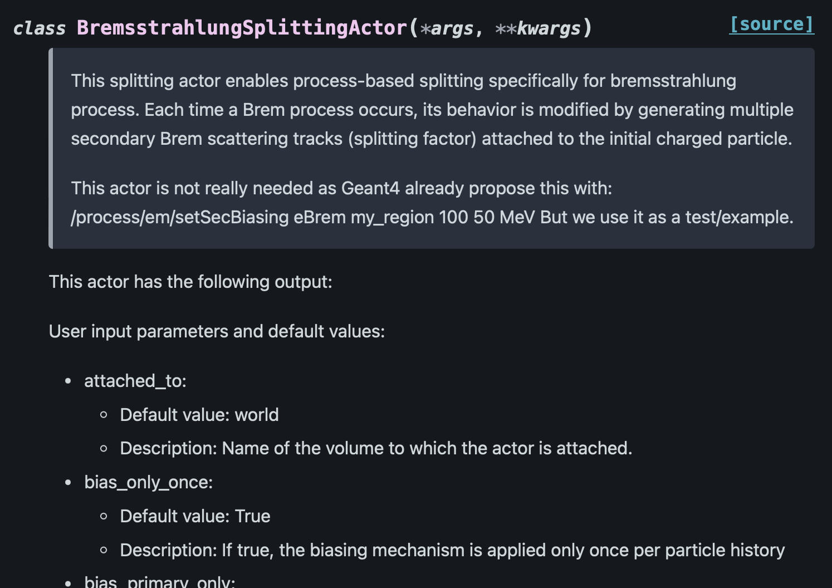
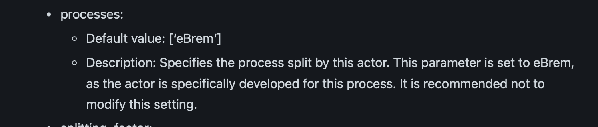
Focus on autodoc
This generates:
Important:
Write meaningful parameter
descriptions.

Slide 14
Consolidation, WIP
Digitizers: coinc sorter, pile-up, dead time
Bug optical materials for voxel: WIP
Source decay: WIP
Production cut issue ? (Martina)
Contrib: Derenzo phantom
Contrib: Carm
Future : generic filters, multiprocess (multicpu) …

Slide 15
Link between Gate and Reconstruction software
Work in progress
Castor: discussion with Thibault Merlin, PET. First version done, still unreleased
PyTomography: discussion with Luke Polson, SPECT. First version done
OpenRTK, discussion with Simon Rit, SPECT
Siemens o7tools, discussion with Jorge Cabello, PET, not open
Coresi (Ane, Voichita) for Compton Camera. Will be done during the AIDER project
List mode format ?
Attenuation map: DONE, but doc not up to date
Working on json file with parameters needed as input
Image or/and Root file format
Future ETSI format for PET

Slide 16
Filters
Currently:
Filter provides “accept” or “reject” at the beginning of the SteppingAction.
Filters can be combined with “or” or “and”.
Complex mixing like: (f1 and f2) or f3 is not possible at the moment
Currently available filters:
  ParticleFilter
  KineticEnergyFilter
  TrackCreatorProcessFilter
  ThresholdAttributeFilter
  UnscatteredPrimaryFilter
Which other filters would be useful?

Slide 17
Next
Phasespace = compton in volume: first version with ”ProcessDefinedStepInVolumeAttribute” PR #758. Doc todo
Multiprocessing
PET Castor interface
PET digitizers : pile-up and dead-time: Thiego
Better, more generic filters

