Slide 1

Agenda – 1 hour max
Gate9.4
Last news
Issues?

Slide 2
Classic GATE – Last devs
Slowly going, not much new features
BioDoseActor
Coincidence Digitizers from old digitizer to new digitizer
New Digitizer Module: Virtual Segmentation SD
New Options in SpatialResolution DM : possible to have position dependent spatial resolution
Option in GateToTree to save Hits from different SDs into one tree

Slide 3
Classic GATE – Issues
Old bug!? What is the history ?
Issue #220 Errors in nPhantomCompton and nPhantomRayleigh
Issue #539 Scatter interaction flag dependent on production cut
  Other old issues to discuss with David after the release of Gate10

Slide 4
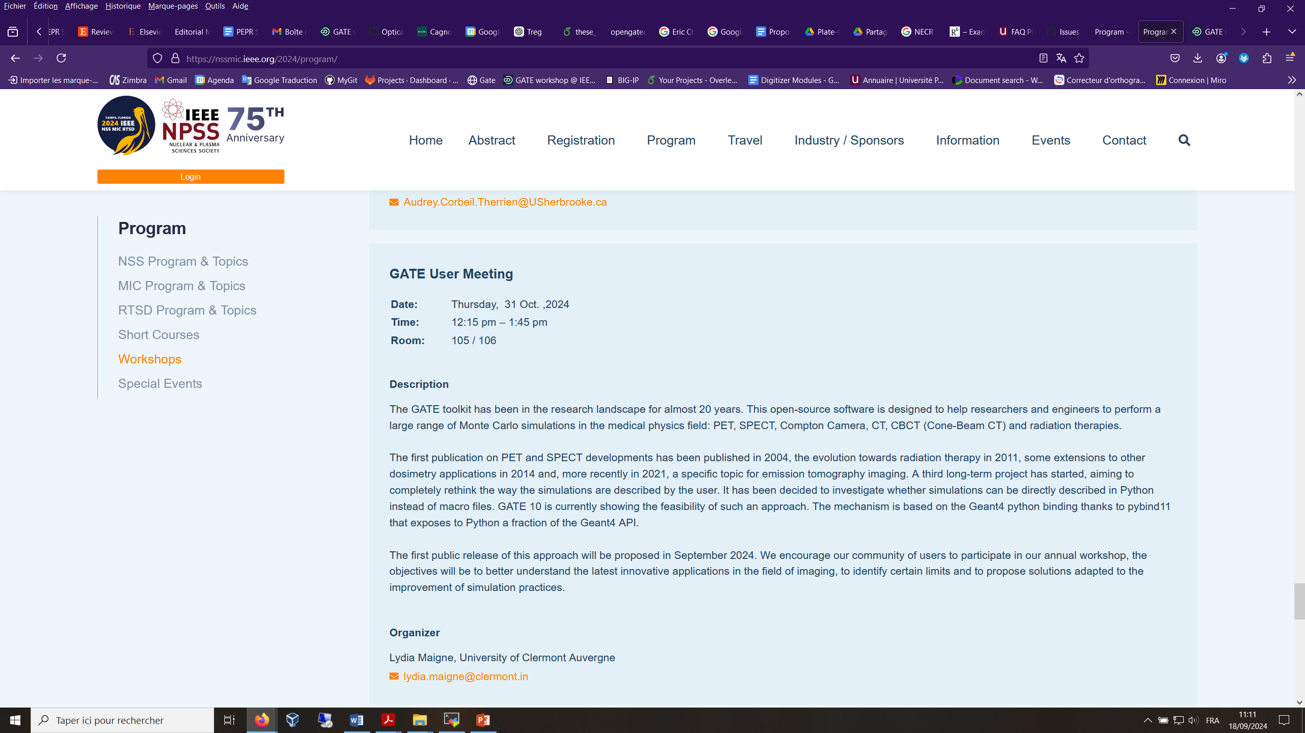
GATE Meeting @ NSS/MIC
Please, send your proposals for contributions!
Indico page
https://indico.in2p3.fr/event/33939/

